Slide 1
Data Science Challenge
Predicting Context from Audio Sensor Recordings
Emmanuel Hammond

Slide 2
Introduction
Audio sensory recordings are part of the mobile sensory data that is collected using mobile application with both versions for iPhone and Android.
Recordings from the mobile sensory data include sensors such as accelerometer, gyroscope, magnetometer, audio sensors, sensors for measuring location and other sensors capturing light, humidity, temperature etc.
However the focus for this presentation is on recordings related to audio sensors (thus audio and audio magnitude)
Audio - 22kHz for ~20sec. Then 13 MFCC features from half overlapping 96msec frames.
Audio magnitude - Max absolute value of recorded audio, before it was normalized.
There are 60 users involved in this analysis with each user reporting examples containing measurement from the audio sensors along side the context labels.

Slide 3
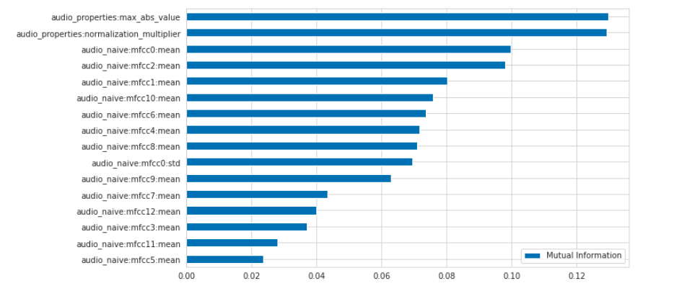
Feature Selection
Audio sensory data provides a number of features and labels which associated with audio. A few of them are mean of audio naive, standard deviation of audio naive, absolute values for audio properties, and the normalised multiplier for audio properties
A check on the relationship among the features were performed, and correlated instances for audio naive (standard deviation) were dropped from the features
In order to understand the general influence of the features on the context label, an check for influence (termed mutual information was performed).
Mutual Importance

Slide 4
Model Definition
Random Forest Classifier
A random forest is a meta estimator that fits a number of decision tree classifiers on various sub-samples of the dataset and uses averaging to improve the predictive accuracy and control over-fitting. The sub-sample size is controlled with the max_samples parameter if bootstrap=True (default), otherwise the whole dataset is used to build each tree.
The default values for the parameters controlling the size of the trees (e.g. max_depth, min_samples_leaf, etc.) lead to fully grown and unpruned trees which can potentially be very large on some data sets.
How it works
The algorithm random samples from the data set provided.
The algorithm will create a decision tree for each sample selected. Then it will get a prediction result from each decision tree created.
Voting will then be performed for every predicted result. For a classification problem, it will use mode, and for a regression problem, it will use mean.
And finally, the algorithm will select the most voted prediction result as the final prediction.

Slide 5
Metrics - Model Evaluation
The following metrics were used to evaluate the models accuracy :
Recall : The fraction of relevant instances that were predicted (called)
Precision : The fraction of of relevant instances that were correctly predicted.
Accuracy : The measure of how often the model is correct.
Confusion matrix : A table that tells us how many our model predicted correctly and incorrectly in terms of binary/multiple outcome classes by comparing actual and predicted cases.

Slide 6
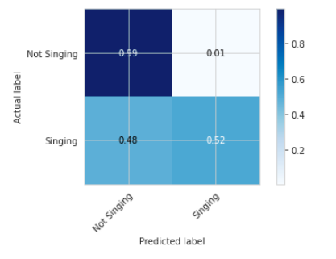
Results & Predictions
Accuracy Report
Misclassification Report
Classes | Precision | Recall | Accuracy
Not Singing | 0.99 | 0.99 | 0.99
Singing | 0.73 | 0.52 | 0.60
Total Accuracy |  |  | 0.755
Sample predictions from the model can be found here.

Slide 7
Reference

